Slide 1
Snakes & Ladders
COAL Project

Slide 2
Group Members :
Ali Raza (P12-6018)
Taimur Rasheed Khan (P12-6097)
Junaid ahmad (P12-6095)

Slide 3
Main Procedures
These are the procedures used in the main:
i) WELCOM
ii) MENU
iii) EASY
iv) HARD
v) INSTRUCTIONS

Slide 4
Each of EASY and HARD Procedure use these Procedures:
i)TABLE
ii)RG
iii)CONDITIONS1
a)WIN1
iv)CONDITIONS2
a)WIN2

Slide 5
Procedures Description:
WELCOM :
This procedure displays the welcom and loading on console screen.
MENU :
This Procedure shows the main menu in which there are three options given, providing the facility to user to choose one of them.

Slide 6
INSTRUCTIONS :
This procedure display’s the instructions to user.
HARD:
This procedure is called when the user choose hard level and this procedure use other procedures which are:
TABLE :
This procedure shows the table, Player 1 and 2’s name and their position at table.

Slide 7
RG :
This procedure generates a random number.
CONDITIONS1 :
This procedure checks the Ladders and Snakes on the table and change the position of player 1 accordingly.
WIN1 :
This procedures shows a message if player 1 win’s.
CONDITIONS2 :
This procedure checks the Ladders and Snakes on the table and change the position of player 2 accordingly.
WIN2 :
This procedures shows a message if player 2 win’s.

Slide 8
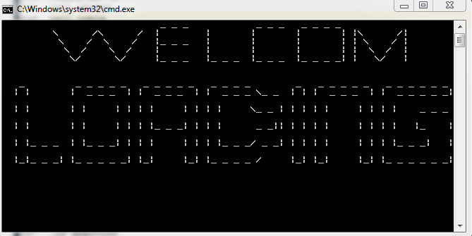

Slide 9
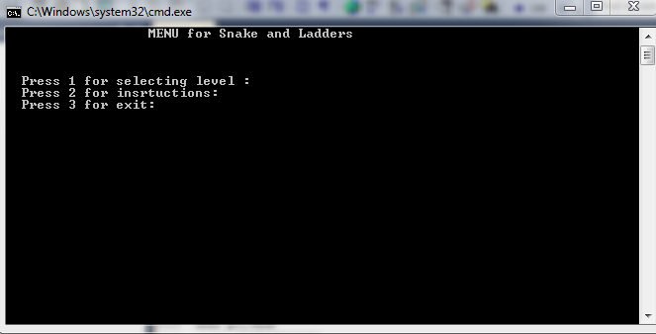

Slide 10
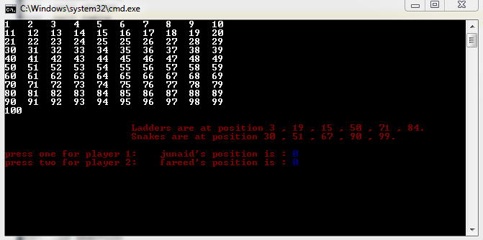

Slide 11
Q & A ???

